Slide 1


Soluto Bot
July 2016
Asurion Internal Use Only

Slide 2
Presentation Outline
Evolution of Soluto
Advent of IoT
Projected growth
Factors affecting growth
Market potential
Other Trends
How Millennials choose to interact
Evolution of bots
Voice based interaction
AVA (aka Soluto Bot)
NLP
Omni-channel
Multiple support modes
Intelligent consumption of telemetry and big data APIs
Application of Vertical Markets
Smart phone support
Smart home support
Device protection claims
Retail/Pre Sales support
Demos
Agent assisted
Semi-autonomous
Guided support
Claims – self service
Asurion Internal Use Only

Slide 3

=
Customer’s Need for Support
Feb 2011
2013
2016
Customers
0
13M
37M
Soluto Customers
Tech Experts
4
1,000
3,000
Continents
1
1
4
2011
2012
2013
2014
2015
2016
Asurion Internal Use Only

Slide 4
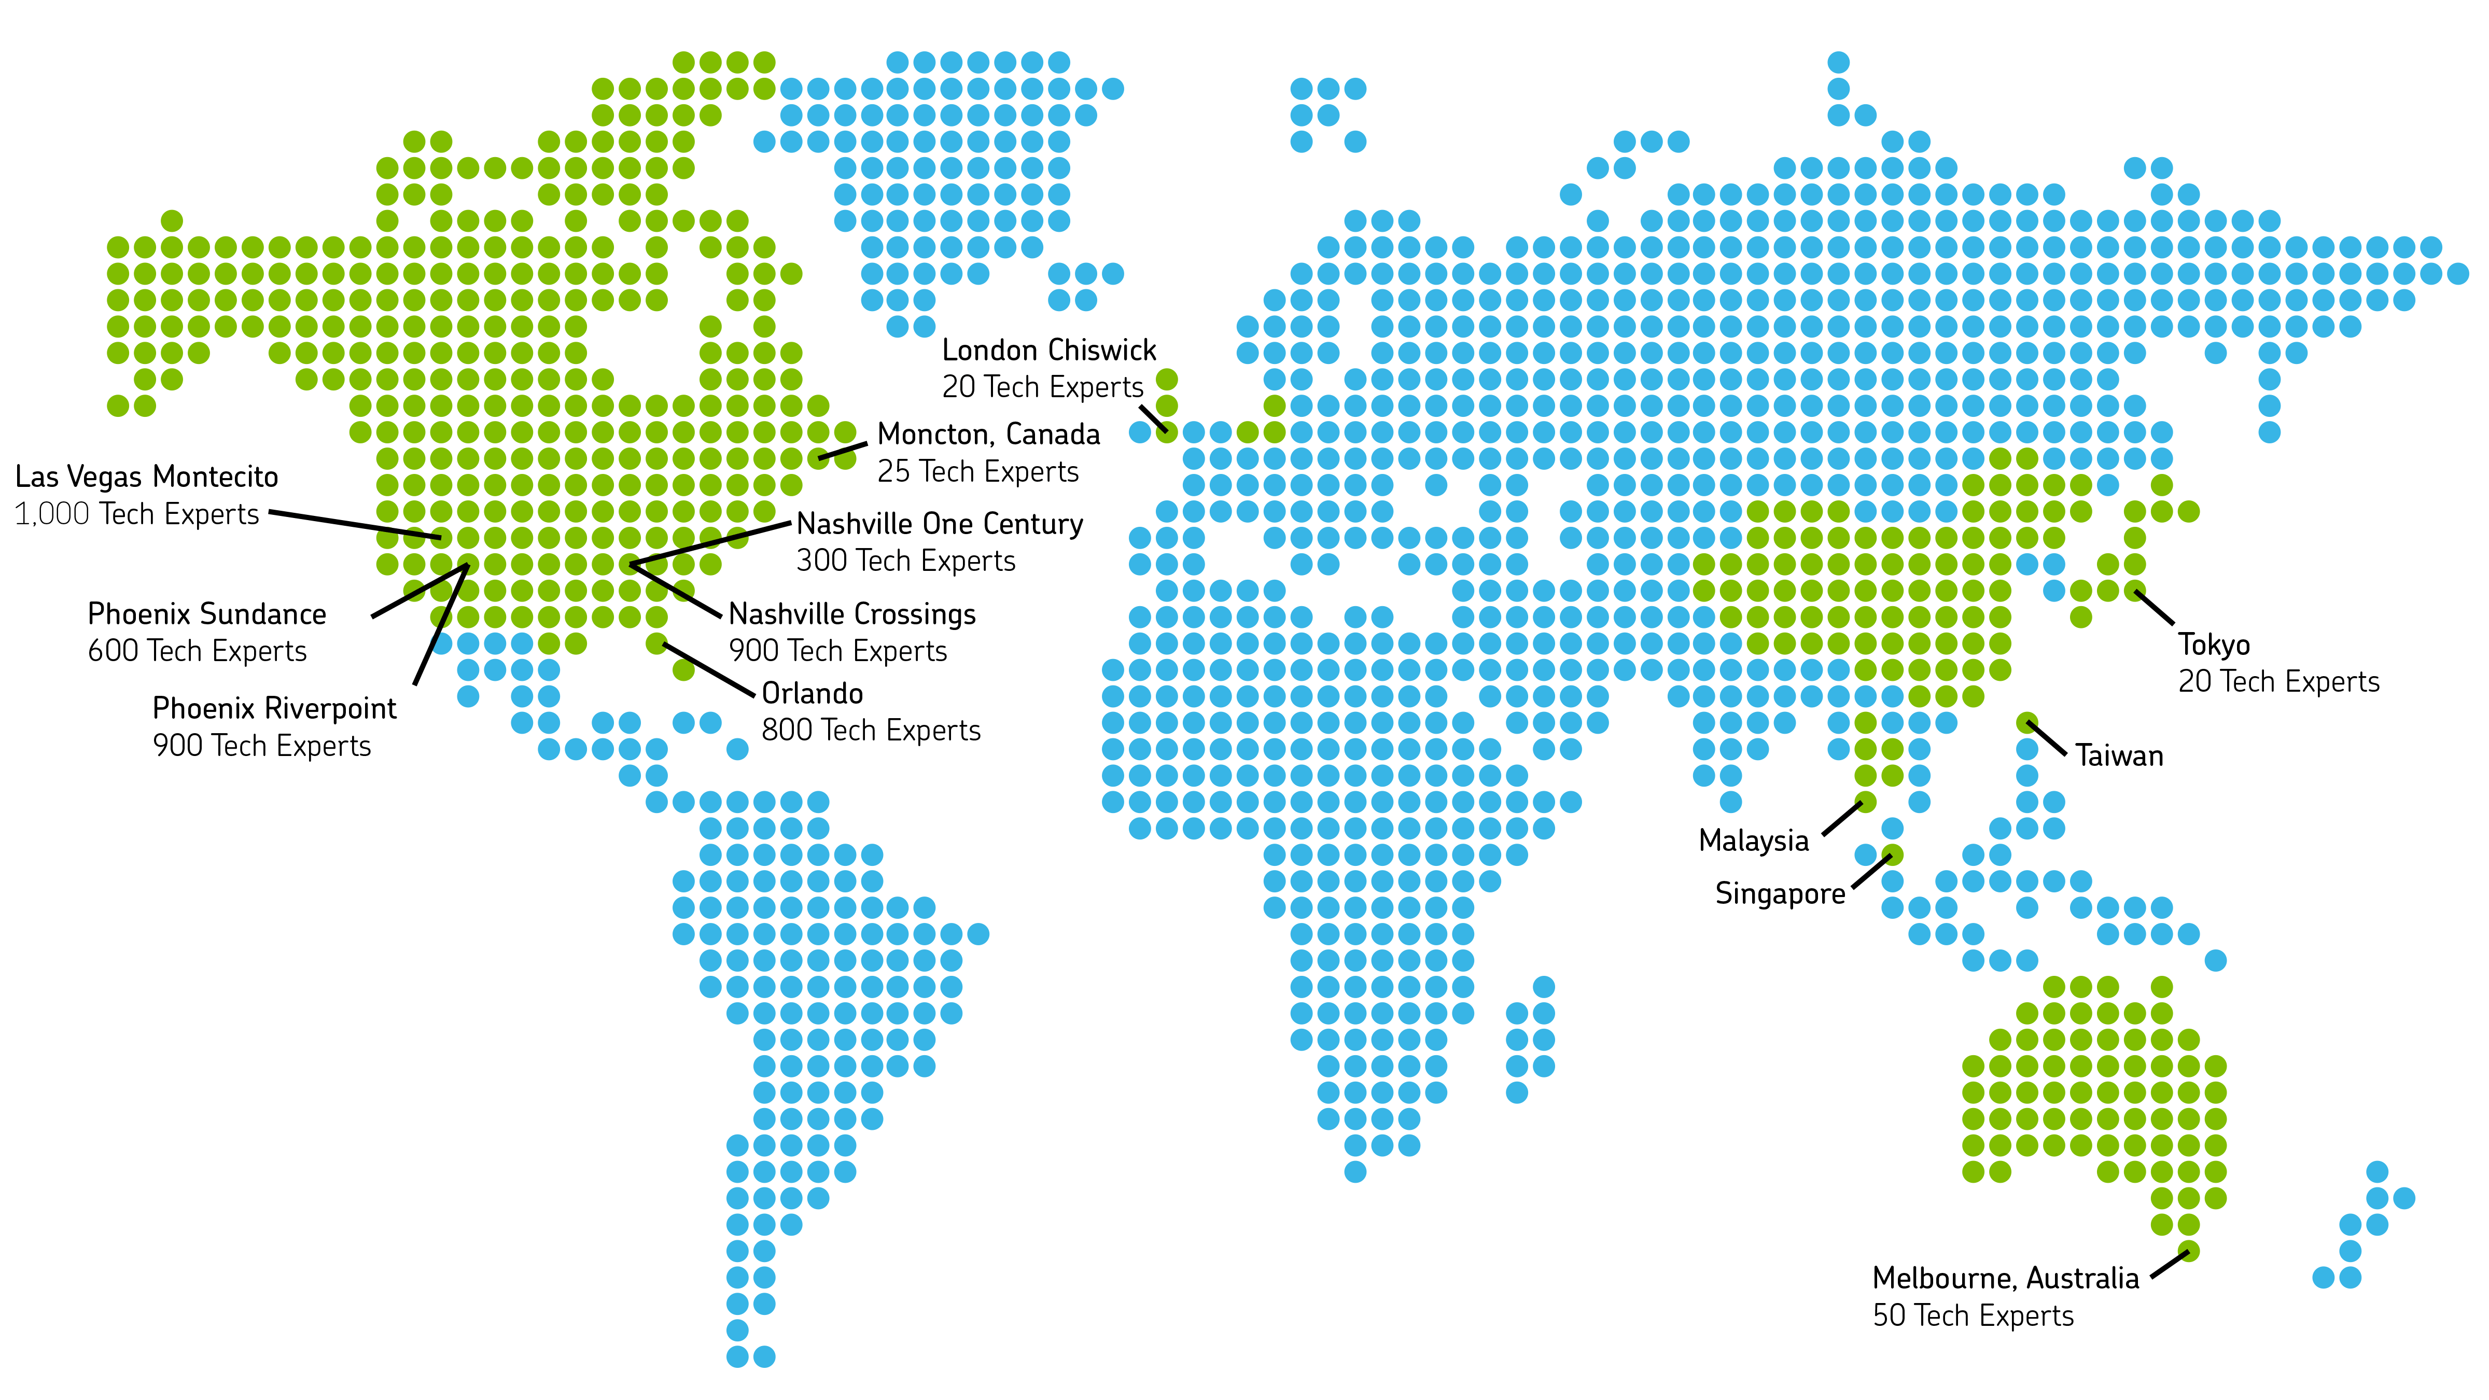
=
Customer’s Need for Support
US Carriers Supported by: 4500+ Technicians 6 Call Centers
Asurion Internal Use Only

Slide 5
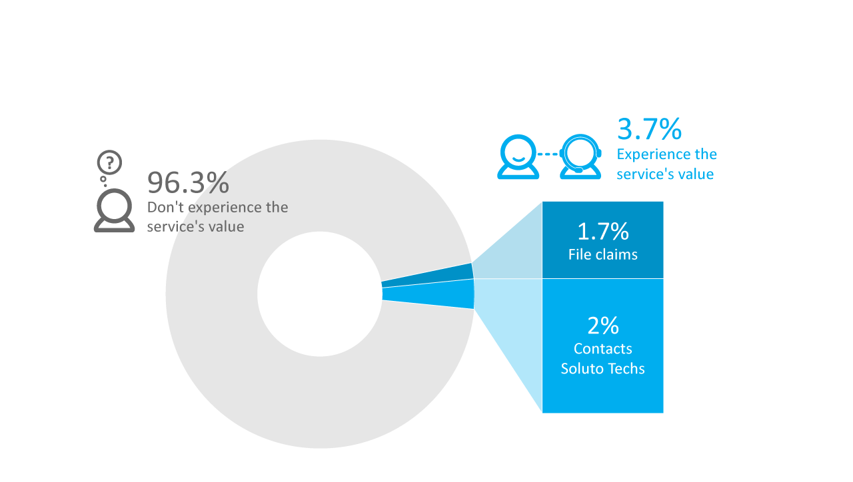
=
The Current Value of Our Service
Asurion Internal Use Only

Slide 6

How many tech experts will we need if we manage to engage our entire user base?
Asurion Internal Use Only

Slide 7
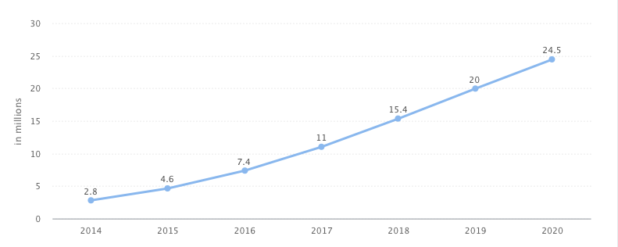

=
Increased Need for Support
17.2
Connected Devices Per Household
6.8
24.5 Million Smart Homes by 2020
2015
2020
Asurion Internal Use Only

Slide 8


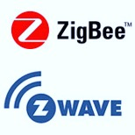




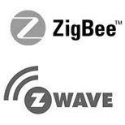
=
Factors Supporting Growth
DEVICES
SECURE
GATEWAY
CLOUD
BIG DATA
SUPPORT
Asurion Internal Use Only

Slide 9
=
6 Factors Supporting Growth
Proliferation of Venture Investing in the IoT sector to fund innovation
Ubiquitous and Cheap Mobility in Emerging Markets and new M2M communication to send the data to the cloud
Affordable, smaller and more powerful sensors
Big Data Analytic Tools and Platforms to analyze the data for Insights
Sophisticated Cloud-based Infrastructure to store the data
Biometric Identification Capabilities for Authentication
Asurion Internal Use Only

Slide 10


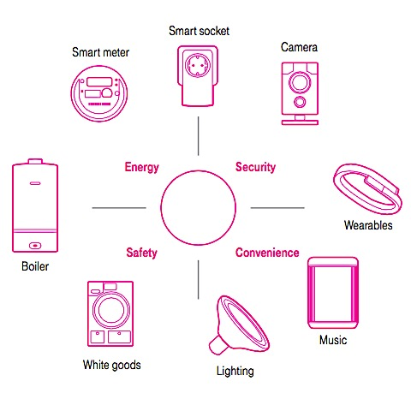



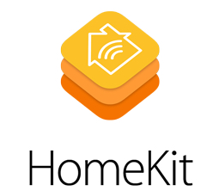


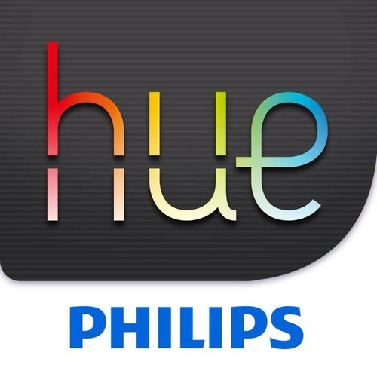
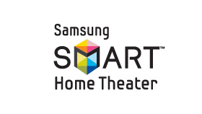
=
Smart Homes Consumer Needs
Safety and Security
Alert when there is a fire in the home
Alert when windows/doors are opened when you are away
Energy
Alert when energy usage is abnormally high
Convenience
Remotely lock and unlock doors in the home
Remotely turn on/off lights in the home
Remotely program, monito and adjust thermostat in the home
Automatically adjust appliance settings to minimize energy consumption
Alert when there’s a water leak
Monitor the home with security cameras
Use voice commands to control devices and call for services (uber, pizza)
Asurion Internal Use Only
Soon all home products will be smart home products.
Does BestBuy sell any non-smart TVs today?

Slide 11


Slide 12
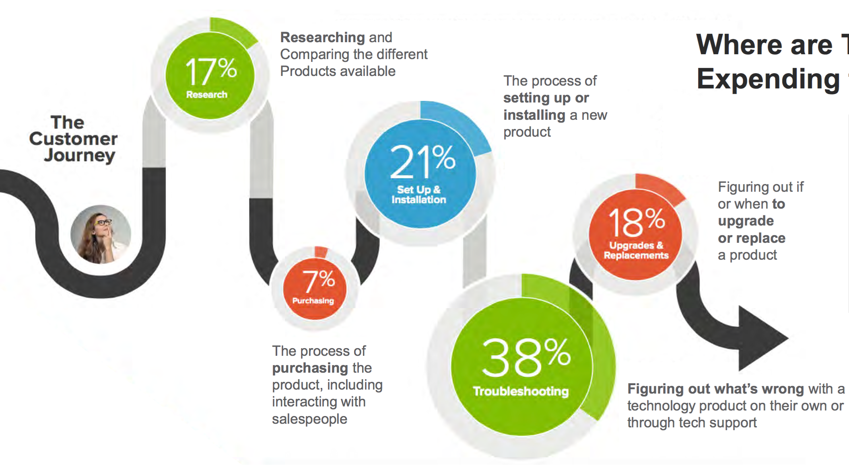
Consumer Effort in Journey to a Smart Home
Researching and comparing product features and compatibility of all available products
Dealing with the Complexity of Setup and limitations with Interoperability
When to Upgrade, Service or Replace a product
79% of people
would prefer a one-stop source to resolve all of the needs with their technology.*
Purchasing Online v/s In-store and dealing with sales personnel.
High costs and Additional costs for professional installations and 3rd party monitoring
Figuring our what's wrong with the product either themselves or with support
Source: Support.com, 2016
Asurion Internal Use Only

Slide 13
=
Smart Home Adoption
Market Constraints
Setup/maintenance complexity
Limited inter-operability
High Costs Today’s Models Don’t Scale Do-it-for-me:
Closed ecosystem
High monthly fees
Do-it-yourself
Wild-west
Asurion Internal Use Only

Slide 14
IoT and Smart Home growth will further increase need for support
Asurion Internal Use Only

Slide 15
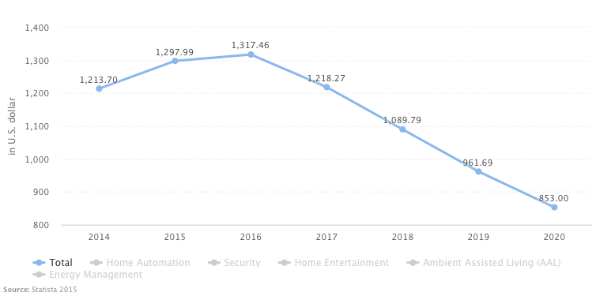
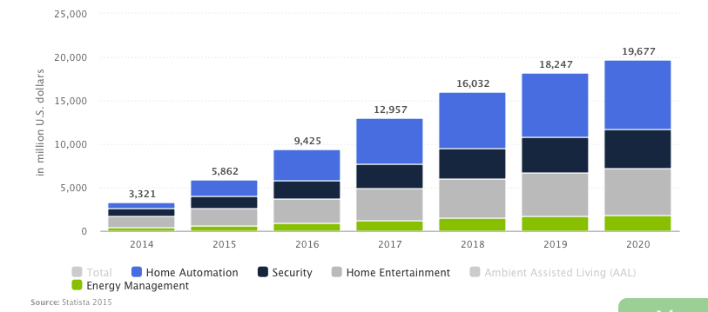
Smart Homes Market Potential

Slide 16
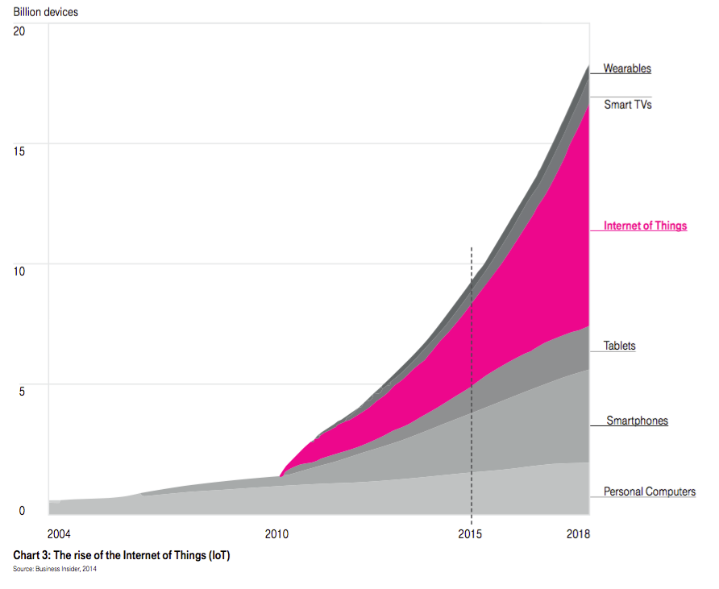
=
Smart Home Potential Market
Growth of Connected IoT devices is going to overtake the growth of smart phones by 2018 (9B)
IDC: $1.7T overall opportunity in 2020
Frost and Sullivan: Tech support 11% of IoT market
IoT market will dwarf smartphone market
Device interoperability and vendor proliferation fuels need for specialized support IoT Device market will be 3x the size of smart phone market by 2018
Current Market for IoT (2.6B)
Currently Supported Smartphone Share (2B)
Asurion Internal Use Only

Slide 17
User Preferences Are Changing Too…
Asurion Internal Use Only

Slide 18
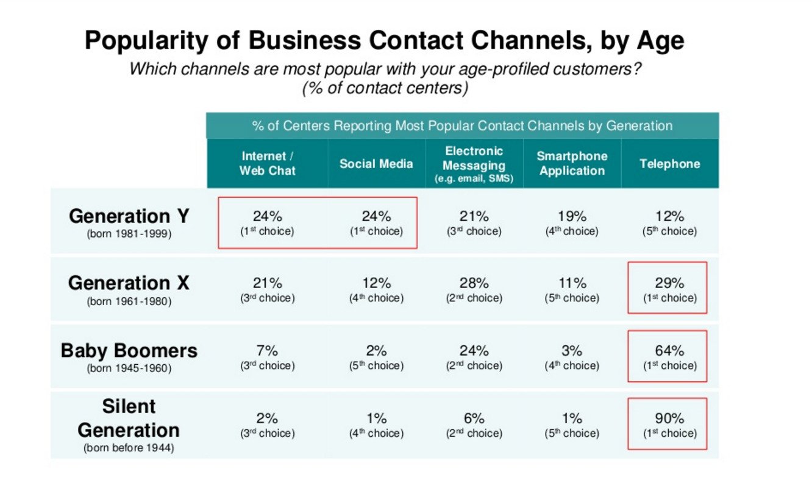

Slide 19
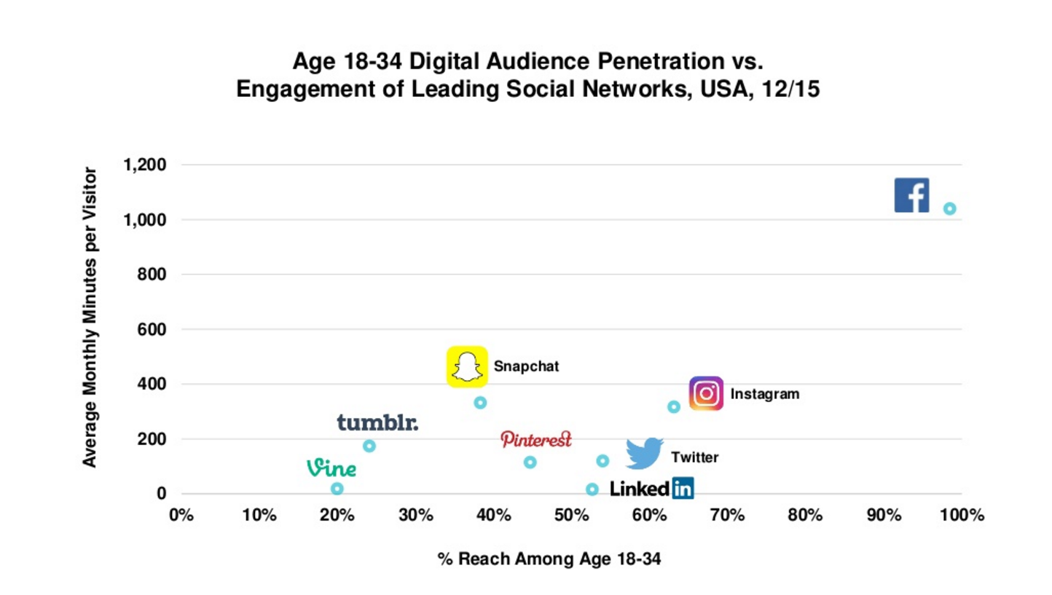

Slide 20
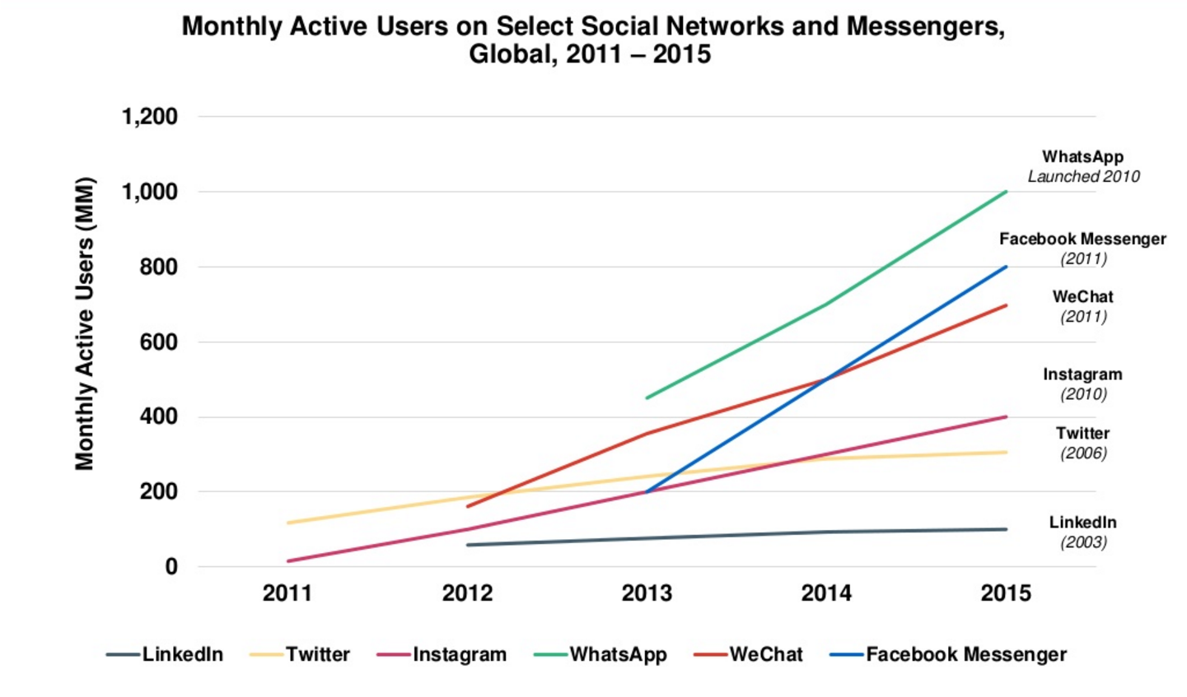

Slide 21
And We Need to Keep Pace with Technology Advancements…
Asurion Internal Use Only

Slide 22
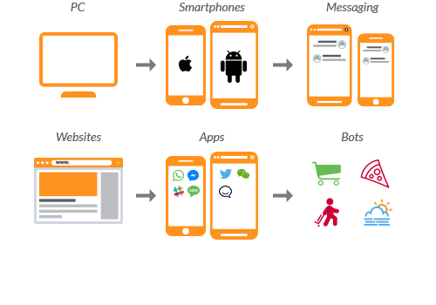
The Paradigm Shift

Slide 23
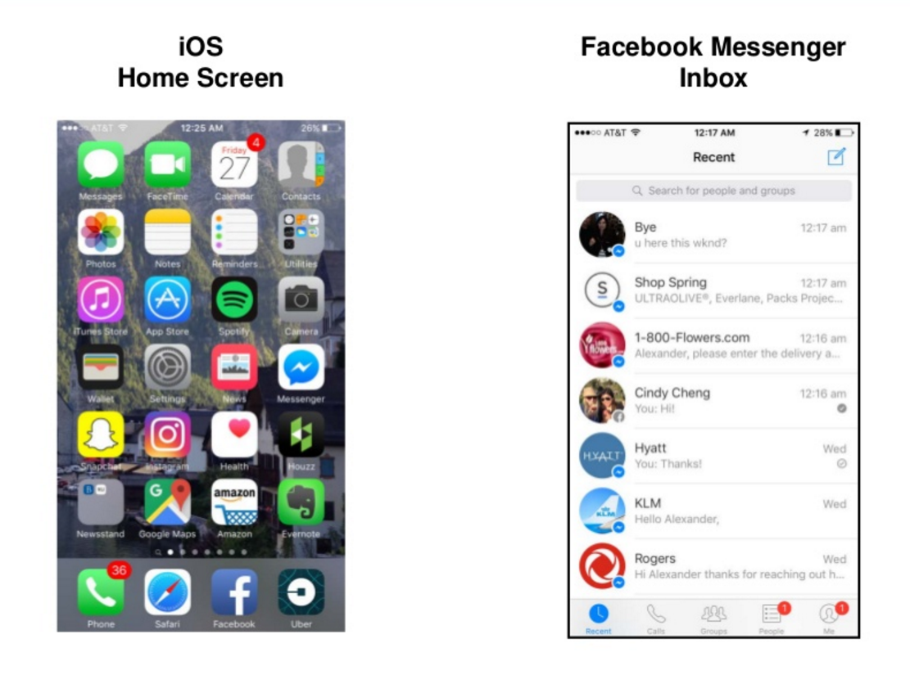
Advent of Bots and Voice Interactions
IVR evolves to ITR (Interactive Text Response)
Voice based Interactions

Slide 24
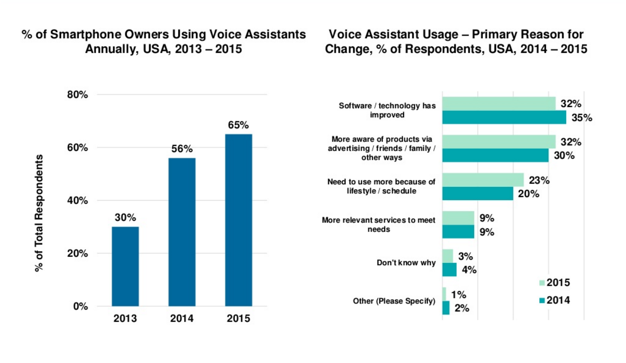

Slide 25
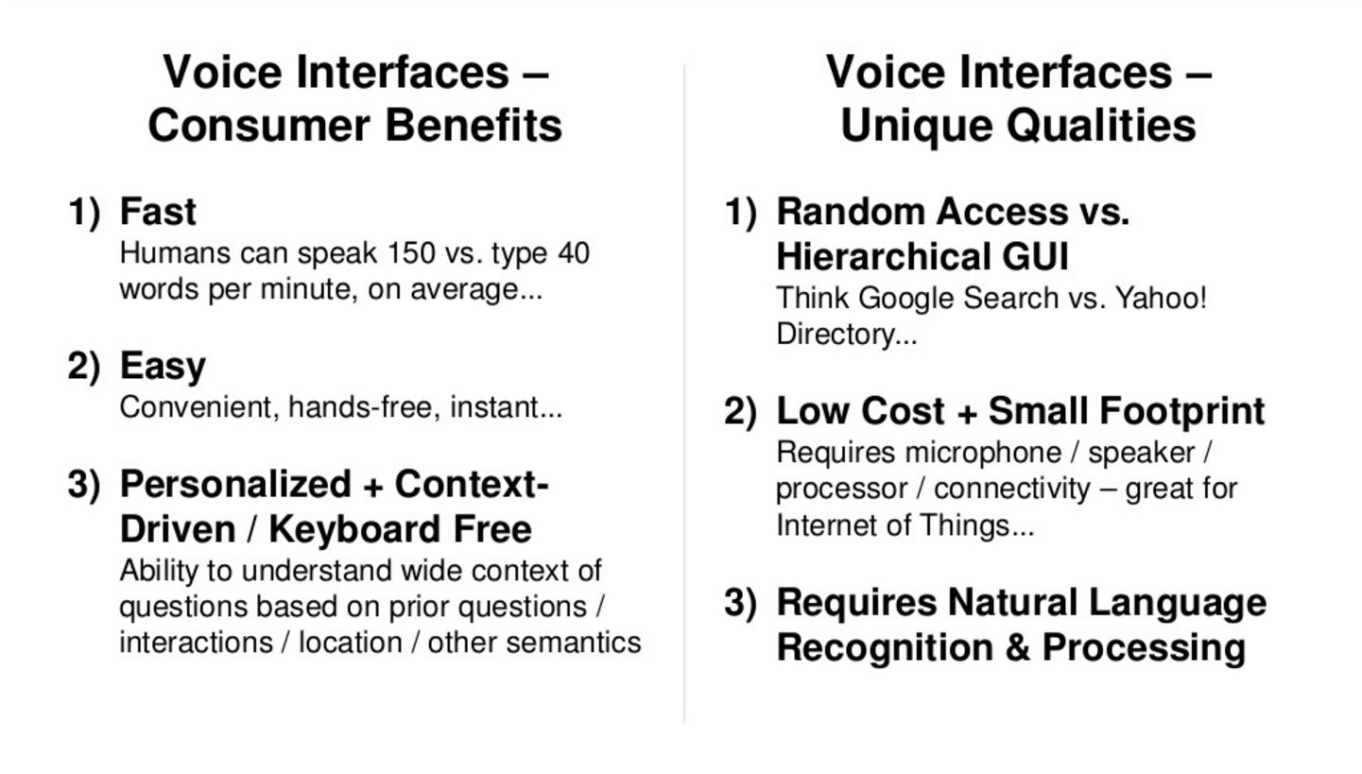

Slide 26
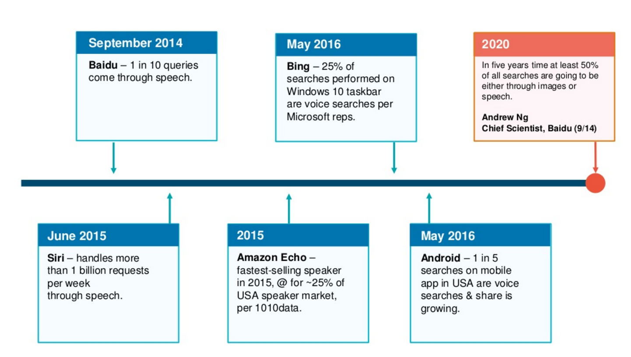

Slide 27
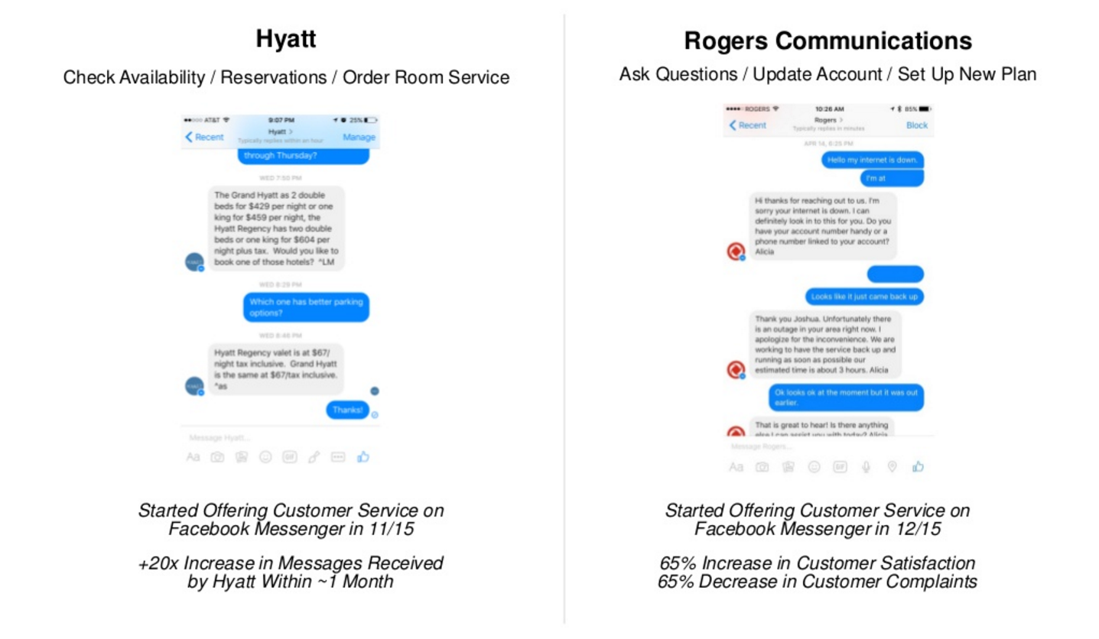
=
Impact of Support Via Popular Channels
Business Goals
Repeat buyers
Engaged customer
Reduced churn
Increased Brand Loyalty
Support becomes the new Sales and Marketing Channel providing Upsell and Upgrade opportunities
Customer support quality will become a factor in purchase decision
Asurion Internal Use Only

Slide 28
How Do We Meet This Increased Demand?
Asurion Internal Use Only

Slide 29

=
Next Generation of Support Soluto Bot
Natural language processing and machine learning based bot that uses conversational dialogue to pinpoint the consumer’s tech support issues and provides a step-by-step solution path to resolve the issue. Use for pre-sales guidance, set-up help, and tech support questions. Provide a superior customer experience by providing personalized solutions, 24/7, over any channel; minimize friction using device telemetry and analytics.
Asurion Internal Use Only

Slide 30
=
What Will It Provide?
Focused on Customer Satisfaction – Intelligent Bot
Quick and accurate response – reduce hold and wait times
Reduce amount of information consumer needs to provide for validation
Maintain issue and consumer context in case of transfer to expert agents – remove need to repeat issues.
Blend of Self, Automated and Live Support - Hybrid
Media rich knowledge base for Self Troubleshooting and Product Research
Seamless transition from Self Help to Live Support when required
Automated Intelligent Bots to handle routine support issues.
Immersive and Proactive Support - Ubiquitous
Support through, Social Media, Chat Apps, Product Apps and Web
Omni-Channel support via sms, voice and chat channels
Proactive notifications and issue prevention
Personalized and Contextual Support
Automated detection of the customer
Intelligent routing based on the consumers need
Knowledge of consumers personalized ecosystem
Tracking and utilization of historical issues during the support process
Asurion Internal Use Only

Slide 31
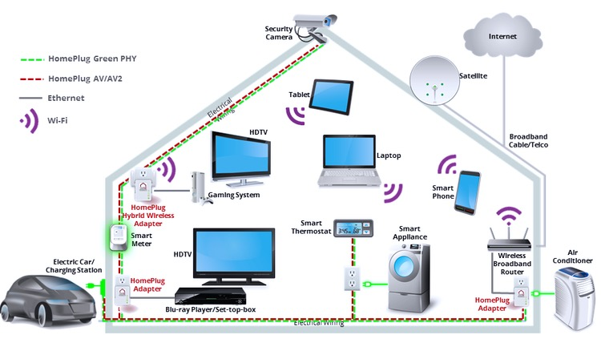


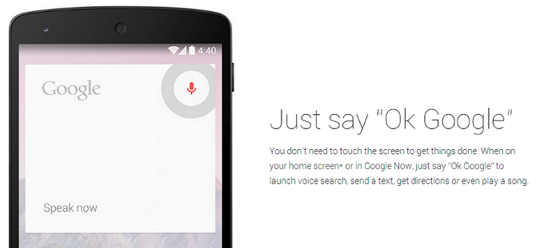
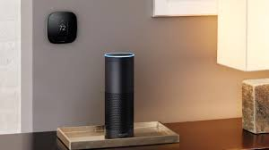

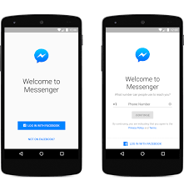


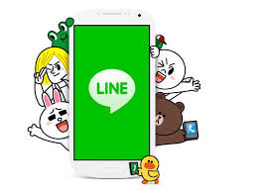
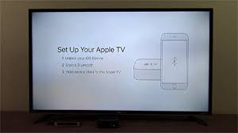
Soluto Bot Capabilities
Personalized
“Contextual Response”
World-leading KB
“Bot parseable, agent/consumer accessible, responsive ”
Intelligent Bot Engine
“Quick, accurate response, no friction, at customers place and time”
Hybrid
“Human agent always available if wanted”
Ubiquitous
“Tech support available where customer is”

Slide 32
Capabilities – How?
Intelligent Bot Engine | Natural Language Processing | Always available – Less wait - instant gratification Context Aware
Ubiquitous | Omni-Channel App (Chat, Call) Social Media (Facebook, Twitter) Chat Apps (Whatsapp, Line, WeChat) SMS Web | Support where the customer wants it Seamless transition from one channel to another without losing context Reduces need for the customer to have to repeat himself and provide the same information multiple times.
Hybrid | Support Modes Self Service Automated Semi-Autonomous Agent-Assisted Live | Achieves the right balance of DIY and DIFM models Offers the right level of support based on customers profile Issue resolution guidance offered to agents and customers
Contextual and Personalized | Intelligent consumption of Telemetry and Big Data APIs | Shortens resolution path Proactive alerts and issue prevention

Slide 33
=
Capabilities – Roadmap
Capability | Current | Short Term | Long Term
NLP | Supervised Learning for Phone Support | Unsupervised Learning Improve based on feedback | Voice 2 Text Multilingual Support
Omni-Channel | App Chat | +App Call, Facebook, Web, SMS | +WeChat, Line, Twitter, Alexa
Support Mode | Agent Assisted Semi-Autonomous | +Autonomous | +Self-Service
API Integrations | Claims | Customer Validation Big Data – Device Settings | Big Data – Persona
Content | Phone Support Claims | Smart Appliances Smart Homes | Retail / Pre Sales Support Multilingual Content
Asurion Internal Use Only

Slide 34
=
Demos
Agent-Assisted - https://youtu.be/tOxEsqjwNw8
Semi-Autonomous – https://youtu.be/Zj62qxaw67Y
Claims – https://youtu.be/AVzFaKdui7M
Facebook- https://youtu.be/oDNN9j5N54Q
Guided Support –
Alexa - https://youtu.be/J7KBWJejs5U
Asurion Internal Use Only

Slide 35
=
Applications Vertical Markets
Self-Service, Agent-Assisted, Automated and Live support for:
Smart Phones
Smart Appliances
Smart Homes
Device Protection Claims
Retail / Pre Sales Support
Internal Uses of Capabilities
Intelligent routing to tech SMEs
Reduced training time for new technicians
Feedback from agents and consumers to continuously improve the system capabilities
Asurion Internal Use Only

Slide 36
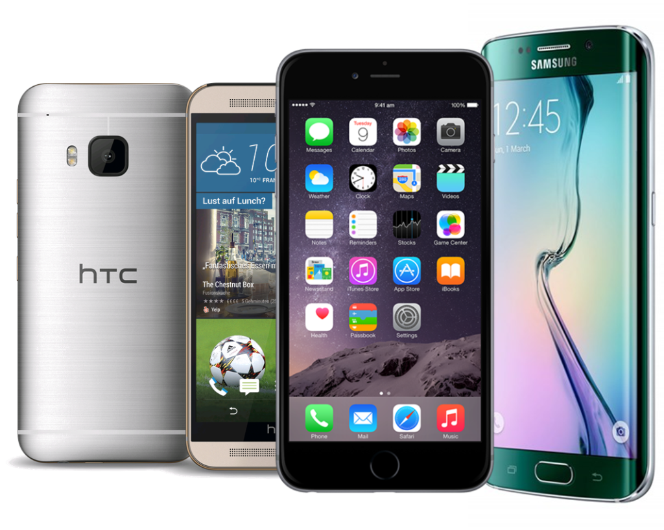

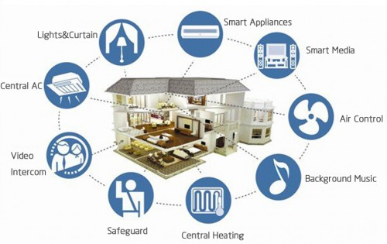
Vertical Markets
Smart Phone Support
Device Protection Claims
Smart Home Support
Sprint, AT&T, APAC
Sprint, AT&T, Verizon, Walmart
Walmart, Amazon, Sprint
24/7 support, less wait, more flexibility, consistency
+
Lower live agent CRT; more interesting problems for agents

Slide 37
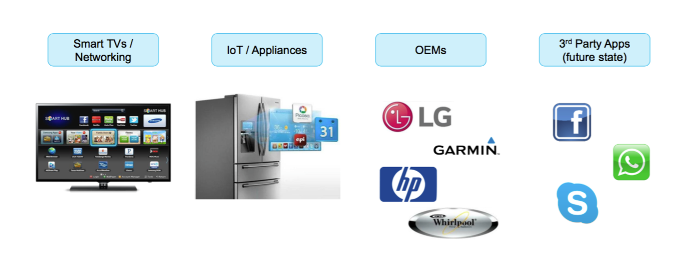
Vertical Markets

Slide 38
=
Knowledge Base Goals
Multi-tenant and Multilingual content that can be delivered to all support channels
Content for both Internal Agents and External Consumers
Granular content that can be reused in multiple resolution paths
Parse-able content that can delivered as URL to tech savvy users or as step-by-step instructions
Asurion Internal Use Only

Slide 39
Knowledge Base Process Now & Future
Listen to calls for trends
Call
Transcription
Analyze text input
Train model
AI
Trainer
Identify new cluster topics
Refine clusters
Content
Developer
Content
Developer
Verizon
Sprint
Create flow
in Visio, upload to Kana
Create HTML instructions in Kana
Create bot-parseable, tagged flow
Create tagged
HTML instructions
External
Services
Kana Search
Kana Feedback
Analytics
AVA NLP Engine/Guided Search
Best Path Alg
Feedback
Analytics
Agent Console
Agent Console
Virtual Agent
Agent
Agent
Consumer

Slide 40
Knowledge Base Process Now & Future
 | Current | Future
Actors | Content Developers, Agents | Content Developers, Agents, Consumers, AI Trainers
Content | Static, Coarse-grain | Bot-parseable, fine-grain Dynamic based on likelihood to solve problem, telemetry, demographics
Channels | Agent Desktop | Agent Desktop Responsive Rich Content - Mobile, Tablet, SMS, Facebook Messenger
Carrier Customization | Different base articles for different carriers with differences | Tag based, w/ carrier-, agent- specific customization
Search | Traditional | NLP-based Guided Search, w/ probabilistic probing questions, results Visually show only relevant content
Toolset | Off-the-shelf Verint/Kana | Custom development based on Asurion agent, content developer needs
Agent
Consumer

Slide 41
